Slide 1
C++ Programming:
From Problem Analysis to Program Design, Fourth Edition
Chapter 1: An Overview of Computers and Programming Languages

Slide 2
Objectives
In this chapter, you will:
Learn about different types of computers
Explore the hardware and software components of a computer system
Learn about the language of a computer
Learn about the evolution of programming languages
Examine high-level programming languages
C++ Programming: From Problem Analysis to Program Design, Fourth Edition

Slide 3
Objectives (continued)
Discover what a compiler is and what it does
Examine a C++ program
Explore how a C++ program is processed
Learn what an algorithm is and explore problem-solving techniques
Become aware of structured design and object-oriented design programming methodologies
Become aware of Standard C++ and ANSI/ISO Standard C++
C++ Programming: From Problem Analysis to Program Design, Fourth Edition

Slide 4
Introduction
Without software, the computer is useless
Software developed with programming languages
  C++ is a programming language
C++ suited for a wide variety of programming tasks
Before programming, it is useful to understand terminology and computer components
C++ Programming: From Problem Analysis to Program Design, Fourth Edition

Slide 5
A Brief Overview of the History of Computers
Early calculation devices
  Abacus, Pascaline
  Leibniz device
  Babbage machines: difference and analytic engines
  Hollerith machine
C++ Programming: From Problem Analysis to Program Design, Fourth Edition

Slide 6
A Brief Overview of the History of Computers (continued)
Early computer-like machines
  Mark I
  ENIAC
  Von Neumann architecture
  Univac
  Transistors and microprocessors
C++ Programming: From Problem Analysis to Program Design, Fourth Edition

Slide 7
Categories of Computers
Mainframe computers
Midsize computers
Micro computers (personal computers)
C++ Programming: From Problem Analysis to Program Design, Fourth Edition

Slide 8
Elements of a Computer System
Hardware
CPU
Main memory
Secondary storage
Input/Output devices
Software
C++ Programming: From Problem Analysis to Program Design, Fourth Edition

Slide 9
Hardware
CPU
Main memory: RAM
Input/output devices
Secondary storage
C++ Programming: From Problem Analysis to Program Design, Fourth Edition

Slide 10
CPU (Central Processing Unit)
CU (Control Unit):
  Fetches and decodes instructions
  Controls flow of information in and out of MM
  Controls operation of internal CPU components
PC (program counter): points to next instruction to be executed
C++ Programming: From Problem Analysis to Program Design, Fourth Edition

Slide 11
CPU (Central Processing Unit) (continued)
IR (instruction register): holds instruction currently being executed
ALU (arithmetic logic unit): carries out all arithmetic and logical operations
C++ Programming: From Problem Analysis to Program Design, Fourth Edition

Slide 12
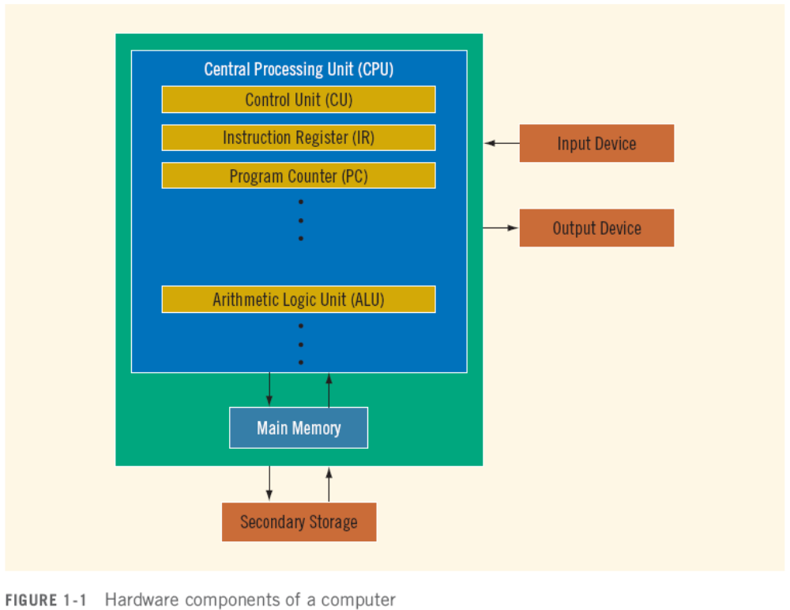

Slide 13
Main Memory
Directly connected to the CPU
All programs must be loaded into main memory before they can be executed
All data must be brought into main memory before it can be manipulated
When computer power is turned off, everything in main memory is lost
C++ Programming: From Problem Analysis to Program Design, Fourth Edition

Slide 14
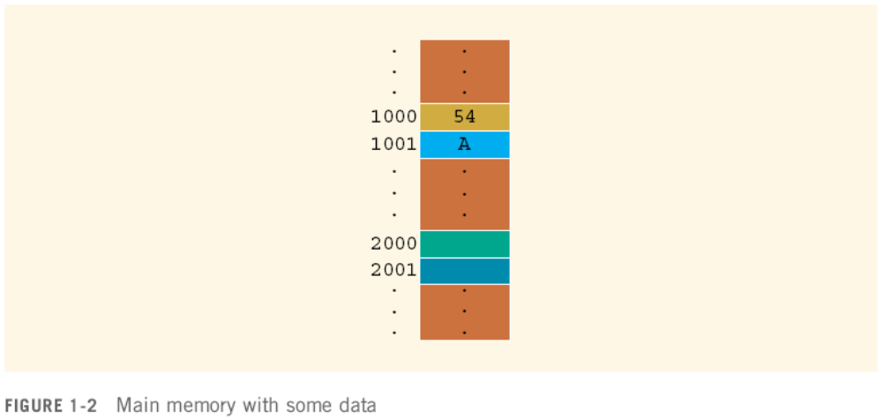

Slide 15
Secondary Storage
Secondary storage: device that stores information permanently
Examples of secondary storage:
  Hard disks
  Flash drives
  Floppy disks
  Zip disks
  CD-ROMs
  Tapes
C++ Programming: From Problem Analysis to Program Design, Fourth Edition

Slide 16
Input/Output Devices
Input devices feed data and programs into computers; they include:
  Keyboard
  Mouse
  Secondary storage
Output devices display results; they include:
  Monitor
  Printer
  Secondary storage
C++ Programming: From Problem Analysis to Program Design, Fourth Edition

Slide 17
Software
Software: programs that do specific tasks
System programs take control of the computer, such as an operating system
Application programs perform a specific task
  Word processors
  Spreadsheets
  Games
C++ Programming: From Problem Analysis to Program Design, Fourth Edition

Slide 18
The Language of a Computer
Digital signals are sequences of 0s and 1s
Machine language: language of a computer
Binary digit (bit):
  The digit 0 or 1
Binary code:
  A sequence of 0s and 1s
Byte:
  A sequence of eight bits
C++ Programming: From Problem Analysis to Program Design, Fourth Edition

Slide 19
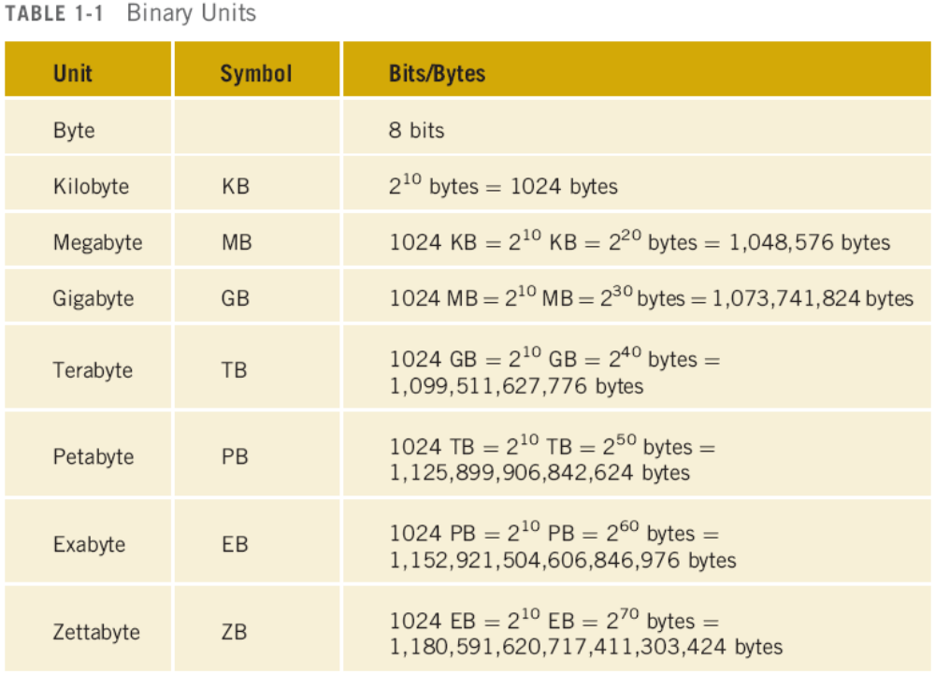

Slide 20
Coding Schemes
ASCII (American Standard Code for Information Interchange)
  128 characters
  A is encoded as 1000001 (66th character)
  3 is encoded as 0110011
C++ Programming: From Problem Analysis to Program Design, Fourth Edition

Slide 21
Coding Schemes (continued)
EBCDIC
  Used by IBM
  256 characters
Unicode
  65536 characters
  Two bytes are needed to store a character
C++ Programming: From Problem Analysis to Program Design, Fourth Edition

Slide 22
The Evolution of Programming Languages
Early computers were programmed in machine language
To calculate wages = rates * hours in machine language:
100100 010001 //Load
100110 010010 //Multiply
100010 010011 //Store
C++ Programming: From Problem Analysis to Program Design, Fourth Edition

Slide 23
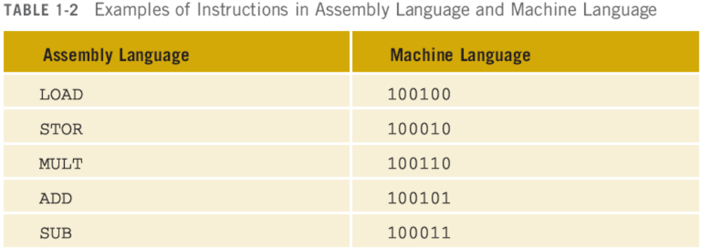
Assembly Language
Assembly language instructions are mnemonic
Assembler: translates a program written in assembly language into machine language
C++ Programming: From Problem Analysis to Program Design, Fourth Edition

Slide 24
Assembly Language (continued)
Using assembly language instructions, wages = rates • hours can be written as:
  LOAD rate
  MULT hour
  STOR wages
C++ Programming: From Problem Analysis to Program Design, Fourth Edition

Slide 25
High-Level Languages
High-level languages include Basic, FORTRAN, COBOL, Pascal, C, C++, C#, and Java
Compiler: translates a program written in a high-level language machine language
The equation wages = rate • hours can be written in C++ as:
wages = rate * hours;
C++ Programming: From Problem Analysis to Program Design, Fourth Edition

Slide 26
A C++ Program
#include <iostream>
using namespace std;
int main()
{
cout << "My first C++ program." << endl;
cout << "The sum of 2 and 3 = " << 5 << endl;
cout << "7 + 8 = " << 7 + 8 << endl;
return 0;
}
Sample Run:
My first C++ program.
The sum of 2 and 3 = 5
7 + 8 = 15
C++ Programming: From Problem Analysis to Program Design, Fourth Edition

Slide 27
Processing a Program
To execute a C++ program:
  Use an editor to create a source program in C++
  Preprocessor directives begin with # and are processed by a the preprocessor
  Use the compiler to:
    Check that the program obeys the rules
    Translate into machine language (object program)
  Software Development Kit (SDK) may be used to create a program
C++ Programming: From Problem Analysis to Program Design, Fourth Edition

Slide 28
Processing a Program (continued)
To execute a C++ program (continued):
  Linker:
    Combines object program with other programs provided by the SDK to create executable code
  Loader:
    Loads executable program into main memory
  The last step is to execute the program
C++ Programming: From Problem Analysis to Program Design, Fourth Edition

Slide 29
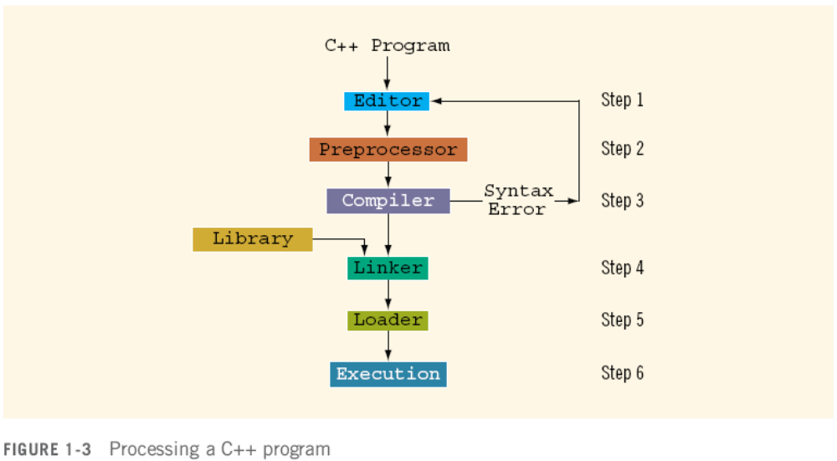

Slide 30
Programming with the Problem Analysis–Coding–Execution Cycle
Programming is a process of problem solving
One problem-solving technique:
  Analyze the problem
  Outline the problem requirements
  Design steps (algorithm) to solve the problem
Algorithm:
  Step-by-step problem-solving process
  Solution achieved in finite amount of time
C++ Programming: From Problem Analysis to Program Design, Fourth Edition

Slide 31
Programming with the Problem Analysis–Coding–Execution Cycle
Step 1 - Analyze the problem
  Outline the problem and its requirements
  Design steps (algorithm) to solve the problem
Step 2 - Implement the algorithm
  Implement the algorithm in code
  Verify that the algorithm works
Step 3 - Maintenance
  Use and modify the program if the problem domain changes
C++ Programming: From Problem Analysis to Program Design, Fourth Edition

Slide 32
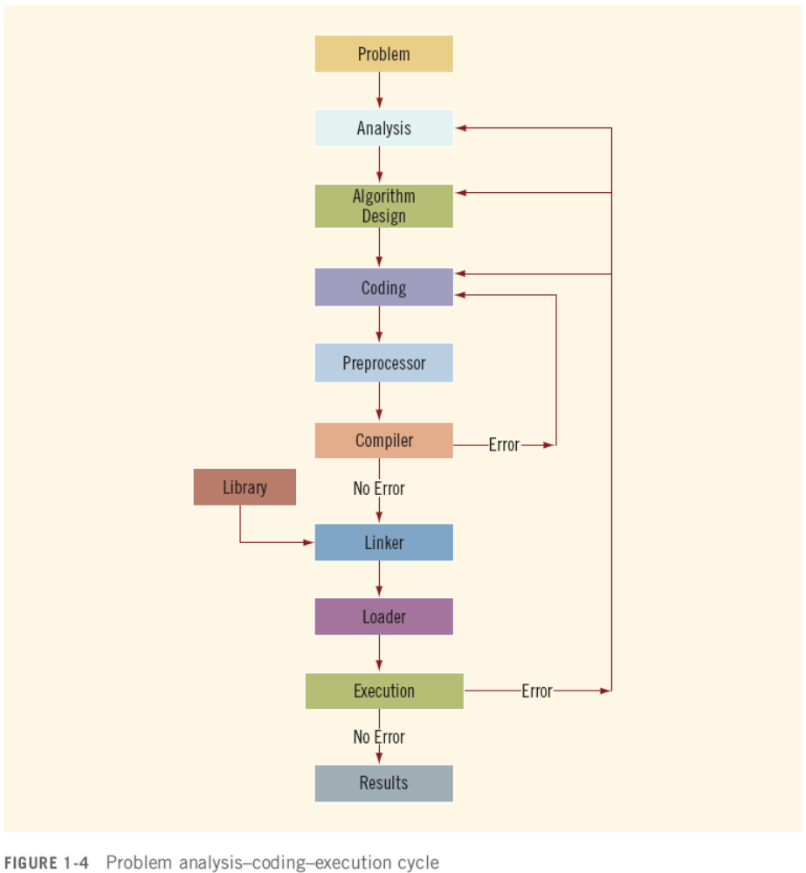

Slide 33
Analyze the Problem
Thoroughly understand the problem
Understand problem requirements
  Does program require user interaction?
  Does program manipulate data?
  What is the output?
If the problem is complex, divide it into subproblems
  Analyze each subproblem as above
C++ Programming: From Problem Analysis to Program Design, Fourth Edition

Slide 34
Design an Algorithm
If problem was broken into subproblems
  Design algorithms for each subproblem
Check the correctness of algorithm
  Can test using sample data
  Some mathematical analysis might be required
C++ Programming: From Problem Analysis to Program Design, Fourth Edition

Slide 35
Write the Code
Once the algorithm is designed and correctness verified
  Write the equivalent code in high-level language
Enter the program using text editor
C++ Programming: From Problem Analysis to Program Design, Fourth Edition

Slide 36
Compiling and Linking
Run code through compiler
If compiler generates errors
  Look at code and remove errors
  Run code again through compiler
If there are no syntax errors
  Compiler generates equivalent machine code
Linker links machine code with system resources
C++ Programming: From Problem Analysis to Program Design, Fourth Edition

Slide 37
The Loader and Executing
Once compiled and linked, loader can place program into main memory for execution
The final step is to execute the program
Compiler guarantees that the program follows the rules of the language
  Does not guarantee that the program will run correctly
C++ Programming: From Problem Analysis to Program Design, Fourth Edition

Slide 38
Example 1-1
Design an algorithm to find the perimeter and area of a rectangle
The perimeter and area of the rectangle are given by the following formulas:
perimeter = 2 * (length + width)
area = length * width
C++ Programming: From Problem Analysis to Program Design, Fourth Edition

Slide 39
Example 1-1 (continued)
Algorithm:
  Get length of the rectangle
  Get width of the rectangle
  Find the perimeter using the following equation:
perimeter = 2 * (length + width)
  Find the area using the following equation:
area = length * width
C++ Programming: From Problem Analysis to Program Design, Fourth Edition

Slide 40
Example 1-3
Every salesperson has a base salary
Salesperson receives $10 bonus at the end of the month for each year worked if he or she has been with the store for five or less years
The bonus is $20 for each year that he or she has worked there if over 5 years
C++ Programming: From Problem Analysis to Program Design, Fourth Edition

Slide 41
Example 1-3 (continued)
Additional bonuses are as follows:
  If total sales for the month are $5,000-$10,000, he or she receives a 3% commission on the sale
  If total sales for the month are at least $10,000, he or she receives a 6% commission on the sale
C++ Programming: From Problem Analysis to Program Design, Fourth Edition

Slide 42
Example 1-3 (continued)
Get baseSalary
Get noOfServiceYears
Calculate bonus using the following formula:
if (noOfServiceYears is less than or equal to five)
bonus = 10 * noOfServiceYears
otherwise
bonus = 20 * noOfServiceYears
Get totalSales
C++ Programming: From Problem Analysis to Program Design, Fourth Edition

Slide 43
Example 1-3 (continued)
Calculate additionalBonus as follows:
if (totalSale is less than 5000)
additionalBonus = 0
otherwise
if (totalSale is greater than or equal to
5000 and totalSale is less than 10000)
additionalBonus = totalSale · (0.03)
otherwise
additionalBonus = totalSale · (0.06)
C++ Programming: From Problem Analysis to Program Design, Fourth Edition

Slide 44
Example 1-3 (continued)
Calculate payCheck using the equation
payCheck = baseSalary + bonus
+ additionalBonus
C++ Programming: From Problem Analysis to Program Design, Fourth Edition

Slide 45
Example 1-5
10 students in a class
Each student has taken five tests and each test is worth 100 points
Design an algorithm to calculate the grade for each student as well as the class average
  Design an algorithm to find the average test score
  Design an algorithm to determine the grade
Data consists of students’ names and their test scores
C++ Programming: From Problem Analysis to Program Design, Fourth Edition

Slide 46
Example 1-5 (continued)
Algorithm to determine the average test score:
  Get the five test scores
  Add the five test scores
    Suppose sum stands for the sum of the test scores
  Suppose average stands for the average test score:
    average = sum / 5;
C++ Programming: From Problem Analysis to Program Design, Fourth Edition

Slide 47
Example 1-5 (continued)
Algorithm to determine the grade:
if average is greater than or equal to 90
grade = A
otherwise
if average is greater than or equal to 80 and less than 90
grade = B
otherwise
if average is greater than or equal to 70 and less than 80
grade = C
otherwise
if average is greater than or equal to 60 and less than 70
grade = D
otherwise
grade = F
C++ Programming: From Problem Analysis to Program Design, Fourth Edition

Slide 48
Example 1-5 (continued)
Main algorithm is as follows:
  totalAverage = 0;
  Repeat the following for each student:
    Get student’s name
    Use the algorithm to find the average test score
    Use the algorithm to find the grade
    Update totalAverage by adding current student’s average test score
  Determine the class average as follows:
    classAverage = totalAverage / 10
C++ Programming: From Problem Analysis to Program Design, Fourth Edition

Slide 49
Programming Methodologies
Two popular approaches to programming design
  Structured
  Object-oriented
C++ Programming: From Problem Analysis to Program Design, Fourth Edition

Slide 50
Structured Programming
Structured design:
  Dividing a problem into smaller subproblems
Structured programming:
  Implementing a structured design
The structured design approach is also called:
  Top-down (or bottom-up) design
  Stepwise refinement
  Modular programming
C++ Programming: From Problem Analysis to Program Design, Fourth Edition

Slide 51
Object-Oriented Programming
Identify components called objects
Specify relevant data and possible operations to be performed on that data
Each object consists of data and operations on that data
An object combines data and operations on the data into a single unit
C++ Programming: From Problem Analysis to Program Design, Fourth Edition

Slide 52
Object-Oriented Programming (continued)
A programming language that implements OOD is called an object-oriented programming (OOP) language
Learn how to represent data in computer memory, how to manipulate data, and how to implement operations
Write algorithms and implement them in a programming language
C++ Programming: From Problem Analysis to Program Design, Fourth Edition

Slide 53
Object-Oriented Programming (continued)
Learn how to combine data and operations on the data into a single unit called an object
C++ was designed to implement OOD
OOD is used with structured design
C++ Programming: From Problem Analysis to Program Design, Fourth Edition

Slide 54
ANSI/ISO Standard C++
C++ evolved from C
C++ designed by Bjarne Stroustrup at Bell Laboratories in early 1980s
C++ programs were not always portable from one compiler to another
In mid-1998, ANSI/ISO C++ language standards were approved
C++ Programming: From Problem Analysis to Program Design, Fourth Edition

Slide 55
Summary
Computer: electronic device that can perform arithmetic and logical operations
Computer system has hardware and software
Central processing unit (CPU): brain
Primary storage (MM) is volatile; secondary storage (e.g., disk) is permanent
Operating system monitors the overall activity of the computer and provides services
C++ Programming: From Problem Analysis to Program Design, Fourth Edition

Slide 56
Summary (continued)
Various kinds of languages, such as machine language, assembly, high-level
Algorithm: step-by-step problem-solving process; solution in finite amount of time
Problem-solving process has three steps:
  Analyze problem and design an algorithm
  Implement the algorithm in code
  Maintain the program
C++ Programming: From Problem Analysis to Program Design, Fourth Edition

Slide 57
Summary (continued)
Structured design:
  Problem is divided into smaller subproblems
  Each subproblem is solved
  Combine solutions to all subproblems
Object-oriented design (OOD): a program is a collection of interacting objects
  Object: data and operations on those data
C++ Programming: From Problem Analysis to Program Design, Fourth Edition

